Slide 1
Ayahuasca
Drug use in Peruvian Religion

Slide 2
“There is virtually no people known to anthropology- however remote, isolated, or primitive in which some form of doctoring with plants was not practiced.” –Barbara Griggs, “The Green Pharmacy”.

Slide 3
Abstract
The attitude towards drugs is rapidly changing. Nine states have legalized marijuana for recreational use and 18 others have decriminalized.
If recreational drugs can be decriminalized, can attitudes surrounding mind-altering drugs for religious ceremonies be too far behind?
Included:
A discussion with Amaru Li, Andean shaman, leader of ayahuasca ceremonies for indigenous people
Case Study involving an Eco Tourist who wants to travel to Peru to experience the ayahuasca ceremony

Slide 4
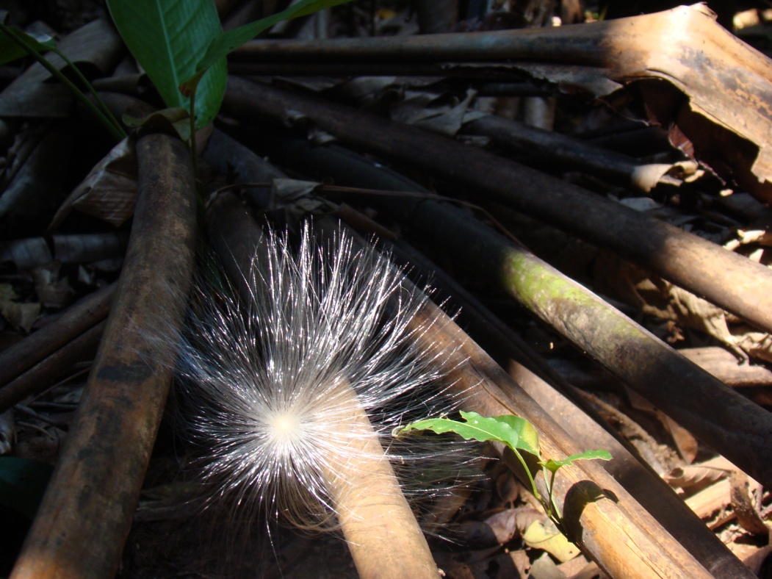
Introduction
What is Ayahuasca?
Entheogenic plant- trance inducing
Vine of the woody Banisteriopsis caapi
Member of the Malpigha family
Produces an alkaloid called Harmine
Used by indigenous peoples of the Amazon River Basin

Slide 5
History of Hallucinogenic Drug Use
Psychoactive Plants have been found in Neolithic cave drawings from 8500 B.C.
About 4,000 plants yield psychoactive substances (Inaba 2011. p. 1.1).
Naturally occurring chemical signals are released by these plants to communicate with neurotransmitters.
These plants offer a substance that elicits a behavioral or physiological response.

Slide 6
History of Hallucinogenic Drug Use
Common hallucinogenic drugs have been regulated and subsequently outlawed regularly.
The Marijuana Tax Act banned the cultivation and use of Cannabis sativa in 1933.
The Comprehensive Drug Abuse Prevention and Control Act of 1970 classified drugs into “Schedules”. The more harmful the lower the number, with Schedule I being the most harmful.

Slide 7
Failure of the D.A.R.E. Program
1983 a program was started in Los Angeles, California called Drug Abuse Resistance Education (DARE)
“A California Study of 5,000 students found that the Los Angeles DARE Program was entirely ineffective in reducing drug use among school children” (Kappeler, 2005. p. 209).
The study found that, DARE was teaching kid about drugs in a way that led to a higher instance of these children experimenting with drug use (Kappeler, 2005. p. 209).

Slide 8
Failure of the D.A.R.E. Program
In those receiving the training, DARE also did not prevent long term drug use (Kappeler, 2005. p. 209).
In the United States 48% of the need for drug treatment is not met (Kappeler, 2005. p.209).
One third of these kids believe that such drugs are not addictive (Byxbe, 2011. p. 35).

Slide 9
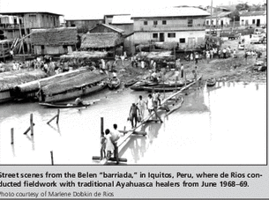
Drugs and Tourism- Peru
Anthropologists started investigating curanderos and ayahuascaqueros in 1968 Peru to determine what, if any, impact they are having on their community.
Word soon spreads to the United States and Europe of the high that accompanies the ayahuasca ritual and drug tourism comes to Peru.

Slide 10
Effect on the United States
Immigration to the United States from Peru
First wave of US Immigration came to New York and New Jersey.
Largest employer, textile factories for alpaca and other textile factories.
New York and New Jersey still have the largest populations of Peruvian immigrants due to reduced production costs in factories.

Slide 11
Effect on the United States
Immigration cont’d
Post WWII US overtakes Europe as most popular immigration destination
Third wave 1970’s during Peru’s textile industry nationalization after the opening of the communist bloc.
Fourth wave 1980’s fleeing governmental changes, violence and economic crisis.

Slide 12
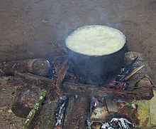
Ayahuasca
The Vine of the Soul:
employed for divinatory and healing purposes by the native peoples of the Amazon and the Andes Mountains.
Note: The vine B. caapi is called ayahuasca, but the brew (also of the same name) is more than a decoction of the vine alone, there are more additional plants that go into the brew that are unique to each shaman, according to Amaru Li, interviewed for this study.
Photo Credit Dr Lindsey Daniels PsyD

Slide 13
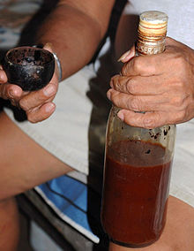
Ayahuasca
It has been noted that effects can be had from imbibing the B. caapi vine alone, but that (N,N-Dimethyltryptamine)DMT-containing plants remain inactive when drunk as a brew without an MAO-inhibitor (such as B. caapi). How indigenous peoples discovered the synergistic properties of the ayahuasca brew remains unknown.
Photo Credit Dr Lindsey Daniels PsyD

Slide 14
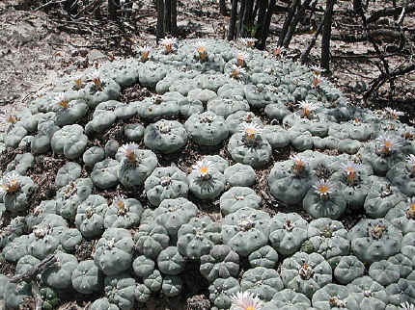
San Pedro Cactus
Mescaline is a naturally occurring psychedelic found in several cactus species, most notably, Peyote (Lophophora williamsii) and San Pedro (Trichocereus pachanoi). Several other members of the trichocereus family also contain mescaline.

Slide 15
San Pedro Cactus
Mescaline belongs to a family of compounds known as phenethylamines, making it quite distinct from the other major psychedelics which belong to the indole family. LSD, psilocybin, harmaline, and DMT are all indoles. Many "designer" psychedelics, such as ecstasy (MDMA) are related to the chemistry of mescaline.

Slide 16
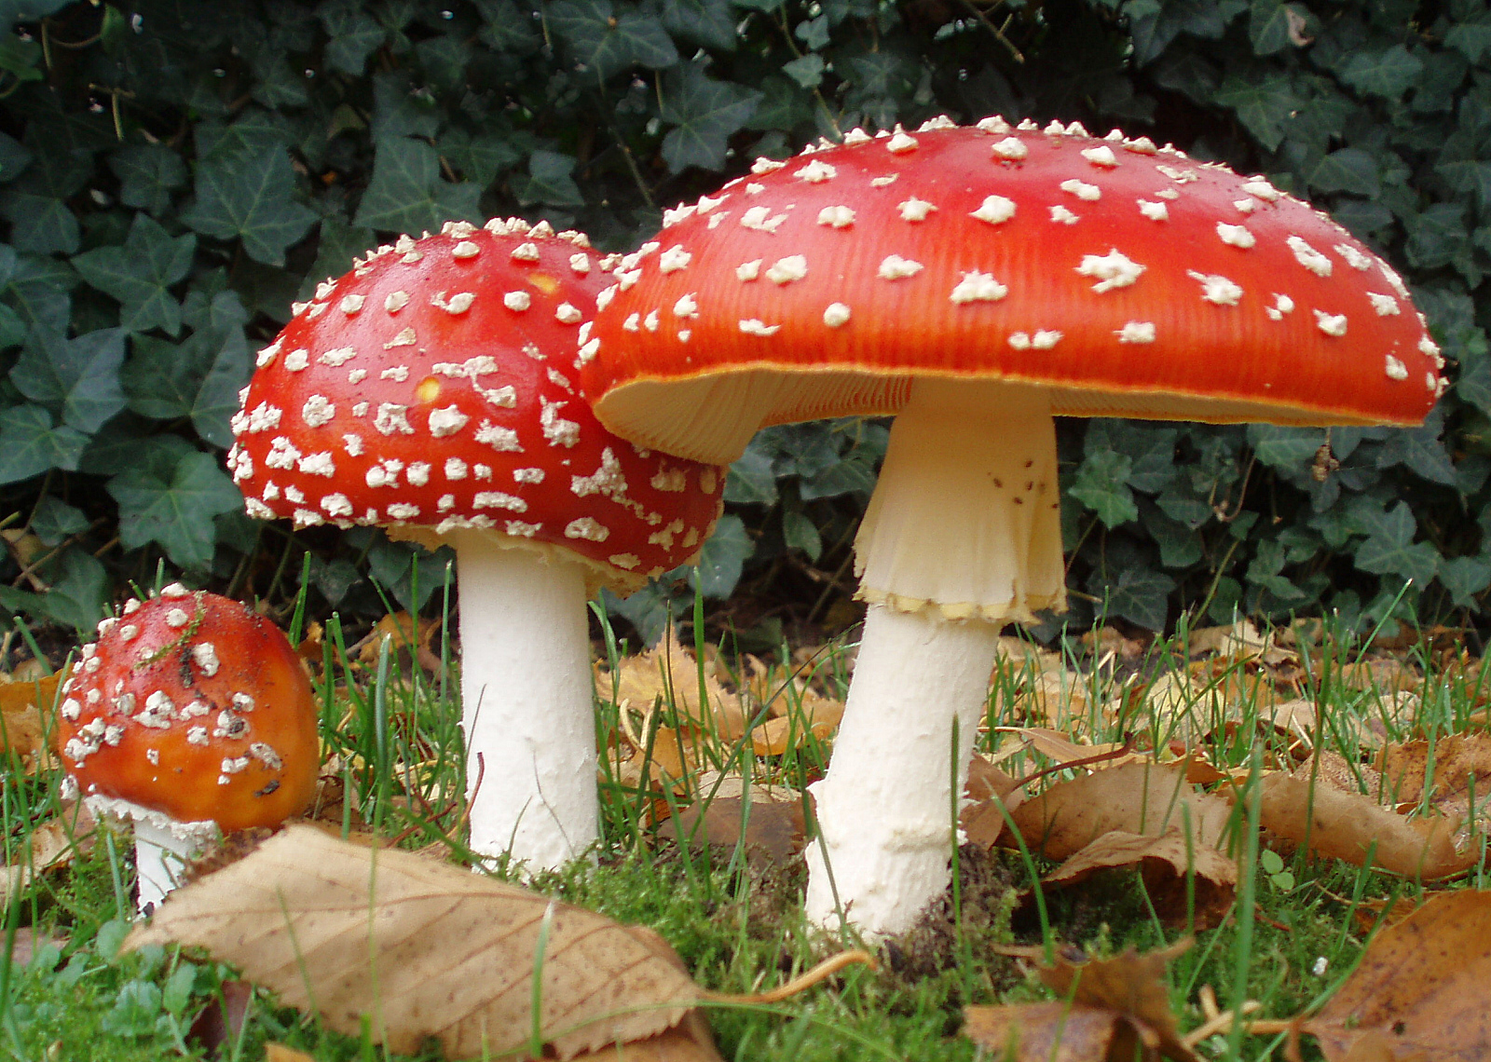
History Continued
Hallucinogenic religious use has such an in-depth history it has been postulated that Christianity evolved from a mushroom fertility cult that use Amanita musicaria and that Christ is an allegory for the sacred mushroom (Mizrach p8, para 1).

Slide 17
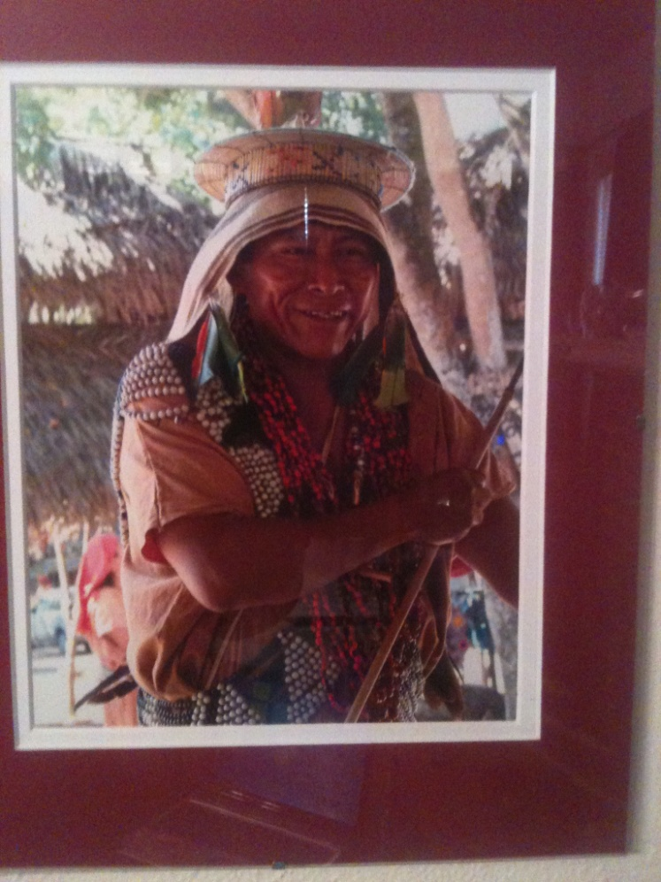
Relationship
Both plants are used by the Q’eros in religious ceremonies to restore balance to the subject.
“We are Born of Chaos, and our life works to restore that balance. When we return to Chaos, it is the job of the Shaman to right that.” – Amaru Li
Photo Credit Dr Lindsey Daniels PsyD

Slide 18
Ayahuasca
Treatment
Contrary to the Drug Tourist Ideal, the high is not the goal. Treatment from the shaman is two-fold.
Create balance in the client by taking them on a journey to the inner self
Treat the body. Ayahuasca is a vermifuge, killing and expelling the worms from the lack of clean water.

Slide 19
Abuse Potential
One of the reasons the United States banned import of the B. caapi vine and labeled it a Schedule I drug is they claimed it has a high potential for abuse because of the hallucinogenic properties.
Schedule I
Schedule I drugs, substances, or chemicals are defined as drugs with no currently accepted medical use and a high potential for abuse.
Source: https://www.dea.gov/druginfo/ds.shtml

Slide 20
Abuse Potential cont’d
The ayahuasca ritual produces a three day long bout of nausea, dizziness, diarrhea, vomiting, lethargy, lightheadedness and hallucinations.
Because of this, the western romanticized notion of a shaman and client going into the woods together for ceremony is simply untrue. Ayahuasca ceremony requires many support staff, to bring water, clean buckets, food for the support staff, drummers and more.

Slide 21
Abuse Potential
Fasting is required for participants of the ritual because
The vomiting is intense and lasts for most of the first day
Foods can interact with the brew and cause unsafe spikes in blood pressure
Doerng-Silveira et al conclude that drug use in a religious setting, with reverence and the weight of the ritual and community involvement is a protective factor in abuse of the drug.

Slide 22
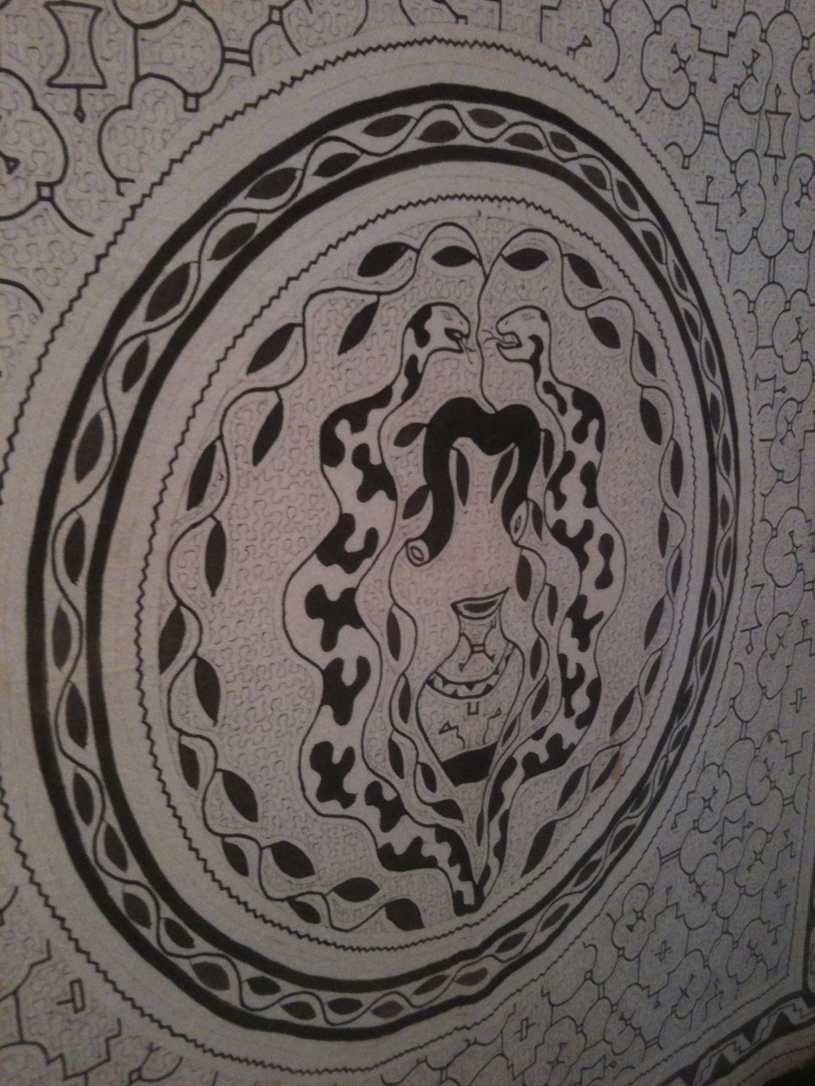
Ayahuasca Ritual
Not all of the Shaman’s healing requires psychotropic medicine. The ceremonies to right a person’s “pacha” can involve drumming, dancing, singing and music as well as medicinal methods.

Slide 23
Shaman’s “Sheet Music”

Slide 24
Ayahuasca as Medicine
Monoamine oxidase inhibitors (MAOIs) are a class of anti-depressant medications commonly prescribed as effective treatments for anxiety, panic disorders, Parkinson’s disease and a-typical depressive disorders.
Shamans and clients both report the anti-depressant effects of the treatment to last more than six months.

Slide 25
Drug Tourism- Peru
People seeking the counsel of the ayahuasca spirits travel from Europe and the United States to the Amazonian region to partake in the ritual where the plant is legal.
Mike, 24, male, native of Delaware
Discovered ayahuasca through research on indigenous shamanic practices in Peru.

Slide 26
Drug Tourism- Mike
”I was drawn to Peru and to ayahuasca, both from it’s history and cultural use and from the beautiful spiritual ceremonies involved in the process(sic).”
“I have been on a mission to visit Peru and participate ever since.”
My first impression (of the ritual) was disgust (over the defecation) and apprehension. I mean, I’m meeting a stranger at the airport to go into the jungle. Who knows if I ever come back.”

Slide 27
Drug Tourism- Mike
“…I nearly gave up on the idea.”
“There is nothing wrong with letting your body do what it does. Nakedness, for instance is accepted and even celebrated.”
“You cannot have joy without pain, or spiritual awakening without physical purging.”

Slide 28
Drug Tourism- Mike
Mike feels that most Americans would see the purging aspect of the ceremony as “gross” and would therefore not seek out ayahuasca.
“The rituals associated with ayahuasca are designed for serious spiritual reflection, not for jollies with your friends.”
Mike states that if that were the goal there are more readily available, “fun-loving party drugs” available.

Slide 29
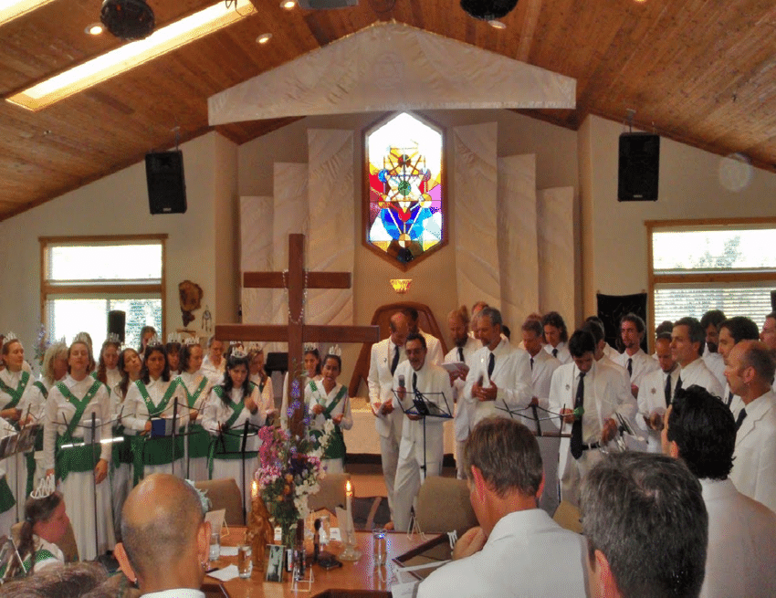
Santo Daime Church
Syncretic religion established in Brazil in the 1920’s
Founder Raimundo Ireneu Serra after he encountered local villagers using ayahuasca
He had visions of the “Queen of the Forest” who he likened to the Virgin Mary.
Incorporating south American shamanism and folk Catholicism, Spiritism and African animism.

Slide 30
Santo Daime Church
What does “Santo Daime” mean?
Santo meaning sainted or holy
Daime is Portuguese for ‘give me’.
Who?
Entire villages, starting with Ceu do Mapia “The Heaven of Mapia”. The first village set up to insulate Daimios from non-believers. Participants from 13 years of age* and up all drink small amounts from the large ceremonial vats, intended for the entire congregation, and sing and dance for hours.
*Participation is always voluntary. Though children as young as three have been reported as partaking of the sacrament.

Slide 31
Santo Daime Church
Are there Santo Daime members outside Brazil?
There are churches in the US, Europe, Japan and there are large concentrations in Holland and Portugal.
Many countries have de facto policies of non-harassment of Daimios (Mizrach p.2 para 4).

Slide 32
Conclusion
It is still debated in court, whether ayahuasca is legal in the United States, as the ayahuasca plants and decoctions are legal, but the DMT-containing plants is questionable, since DMT is a Schedule I drug.
It is even more hotly debated because DMT can be proven to exist naturally in many living things, and appears naturally in human blood and urine.
It is only under certain circumstances that it is able to pass the blood-brain barrier and interact with the brain and cause psychotropic visions and experiences.

Slide 33
Conclusion
A court case was won, allowing the União do Vegetal to import and use the tea for religious purposes in the United States, Gonzales v. O Centro Espirita Beneficente Uniao do Vegetal, was heard by the U.S. Supreme Court on November 1, 2005; the decision, released February 21, 2006, allows the church to use the tea in its ceremonies pursuant to the Religious Freedom Restoration Act.
In a similar case an Ashland, Oregon-based Santo Daime church sued for their right to import and consume ayahuasca tea.
In March 2009, U.S. District Court Judge Panner ruled in favor of the Santo Daime, acknowledging its protection from prosecution under the Religious Freedom Restoration Act.

Slide 34
References
References:
Byxbe, F., , D., Urbina, M., & Nicosia, P. (2011). Prescription drugs: Generation rx in crisis. American Criminal Justice Association LAE Journal, 2011, 34-36.
Doerng-Silveira, E, Grob, C.S., de Rios, M.d., Lopez, Alonzo, L.k. Tacla, C., & Da Silviera, X. (2005) Report on psychoactive drug use among adolescents using ayahuasca within religious context. Journal of Psychoactive Drugs, 37(2), 141-144. doi:10.1080/02791072.2005.10399794
Johnson, L.A., Johnson, R.L. & Alfonzo C. (2011) Uppers, downers and all arounders. (7th ed., p.1-1.22). Medord, Oregon: CNS Productions, Inc.
Inaba, D., & Cohen, W. (2011). Uppers, downers and all arounders. (7th ed., pp. 1-1.22). Medford, Oregon: CNS Productions, Inc.
Kappeler, V., & Potter, G. (2005). The mythology of crime and criminal justice. (Fourth ed., pp. 192-201). Long Grove, Illinois: Waveland Press, Inc.
Ruling by District Court Judge Panner in Santo Daime case in Oregon (PDF), retrieved 2012-01-14

Slide 35
References
Mckenna, D.J., Towers, G.H.N, Abbott, F. (1984). Monoamine oxidase inhibitorsin south American hallucinogenic plants: Tryptamine and b-carboline constituents of ayahuasca. Journal of Ethnopharmacology20(3), 195-223. doi: 10.1016-0378-8741(84)900003-
Mizrach. S. (n.d.) The santo daime religion. Retrieved from
http://www2.fiu.edu/~mixrachs/daime.htm
Riba, J., Valle, M., Urbano, G., Yrita, M., Morte, A., & Barbanoj, M. (2003). Human Pharmacology of ayahuasca: Subjective and cardiovascular effects, monoamine metabolite excretion, and pharmacokinetics. Journal of Phacology and Experimental Therapeutics, 306(1), 73-83. doi: 10.1124-jpet.103.409882

Slide 36
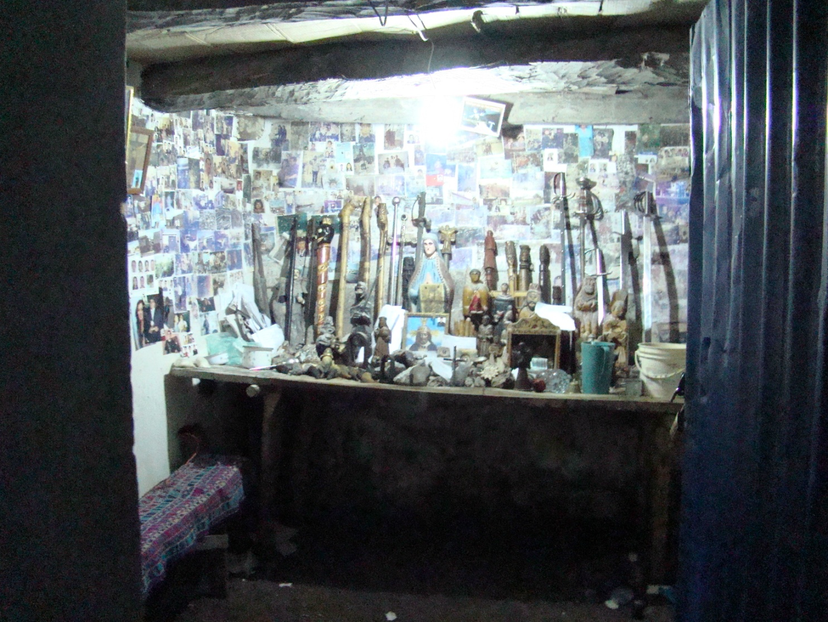
Initiation of a shaman
Photo Credit Dr Lindsey Daniels PsyD

Slide 37
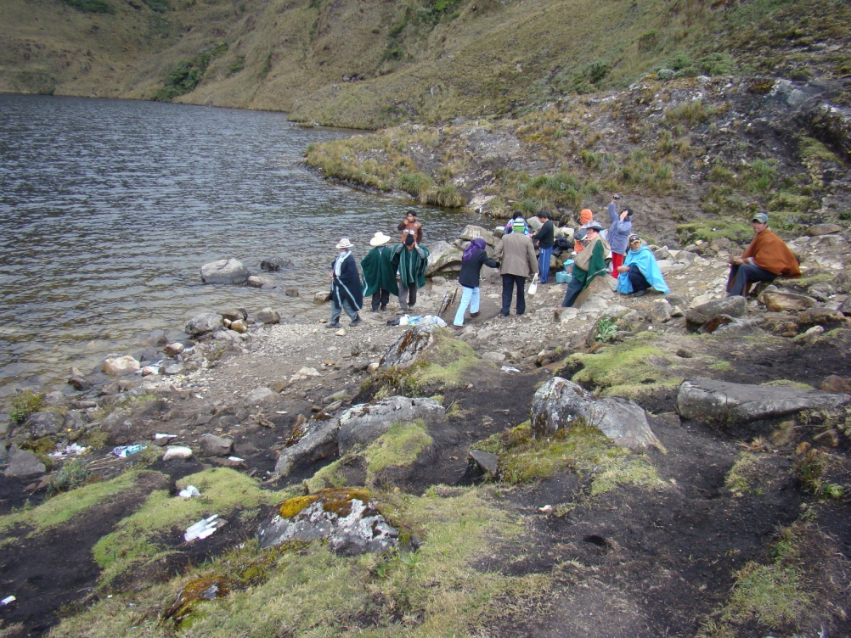
Initiation of a shaman
As well as a steep hike up into the mountain’s hidden river basin. At 15,000+ feet above sea level it’s a frigid journey no matter the time of year.

Slide 38
Initiation of a shaman
The Shaman –to –be must make a frigid dive into icy river waters fed by melting snow to cleanse himself of past disease and energetic ills, while the Maestro or head Shaman calls to the ancestors, the spirits, to the Goddess PachaMama and to the elements to witness his rebirth.
Photo Credit Dr Lindsey Daniels PsyD

Slide 39
Tools
Photo Credit Dr Lindsey Daniels PsyD

Slide 40
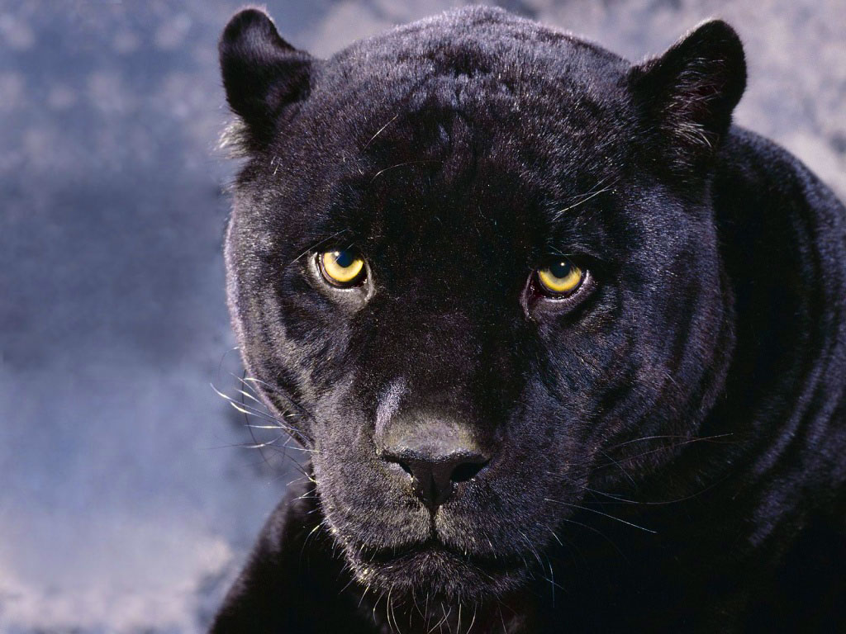
Initiation of a shaman
If you aren’t born with a physical sign of your Shamanic birthright, (two mismatched eye colors, or physical deformities) initiation for the Q’ero who desires to become a Shaman is quite dangerous. For you cannot become a Shaman unless you journey “Through the Eyes of the Puma” in death and return to life.
Initiation of a Shaman

Slide 41
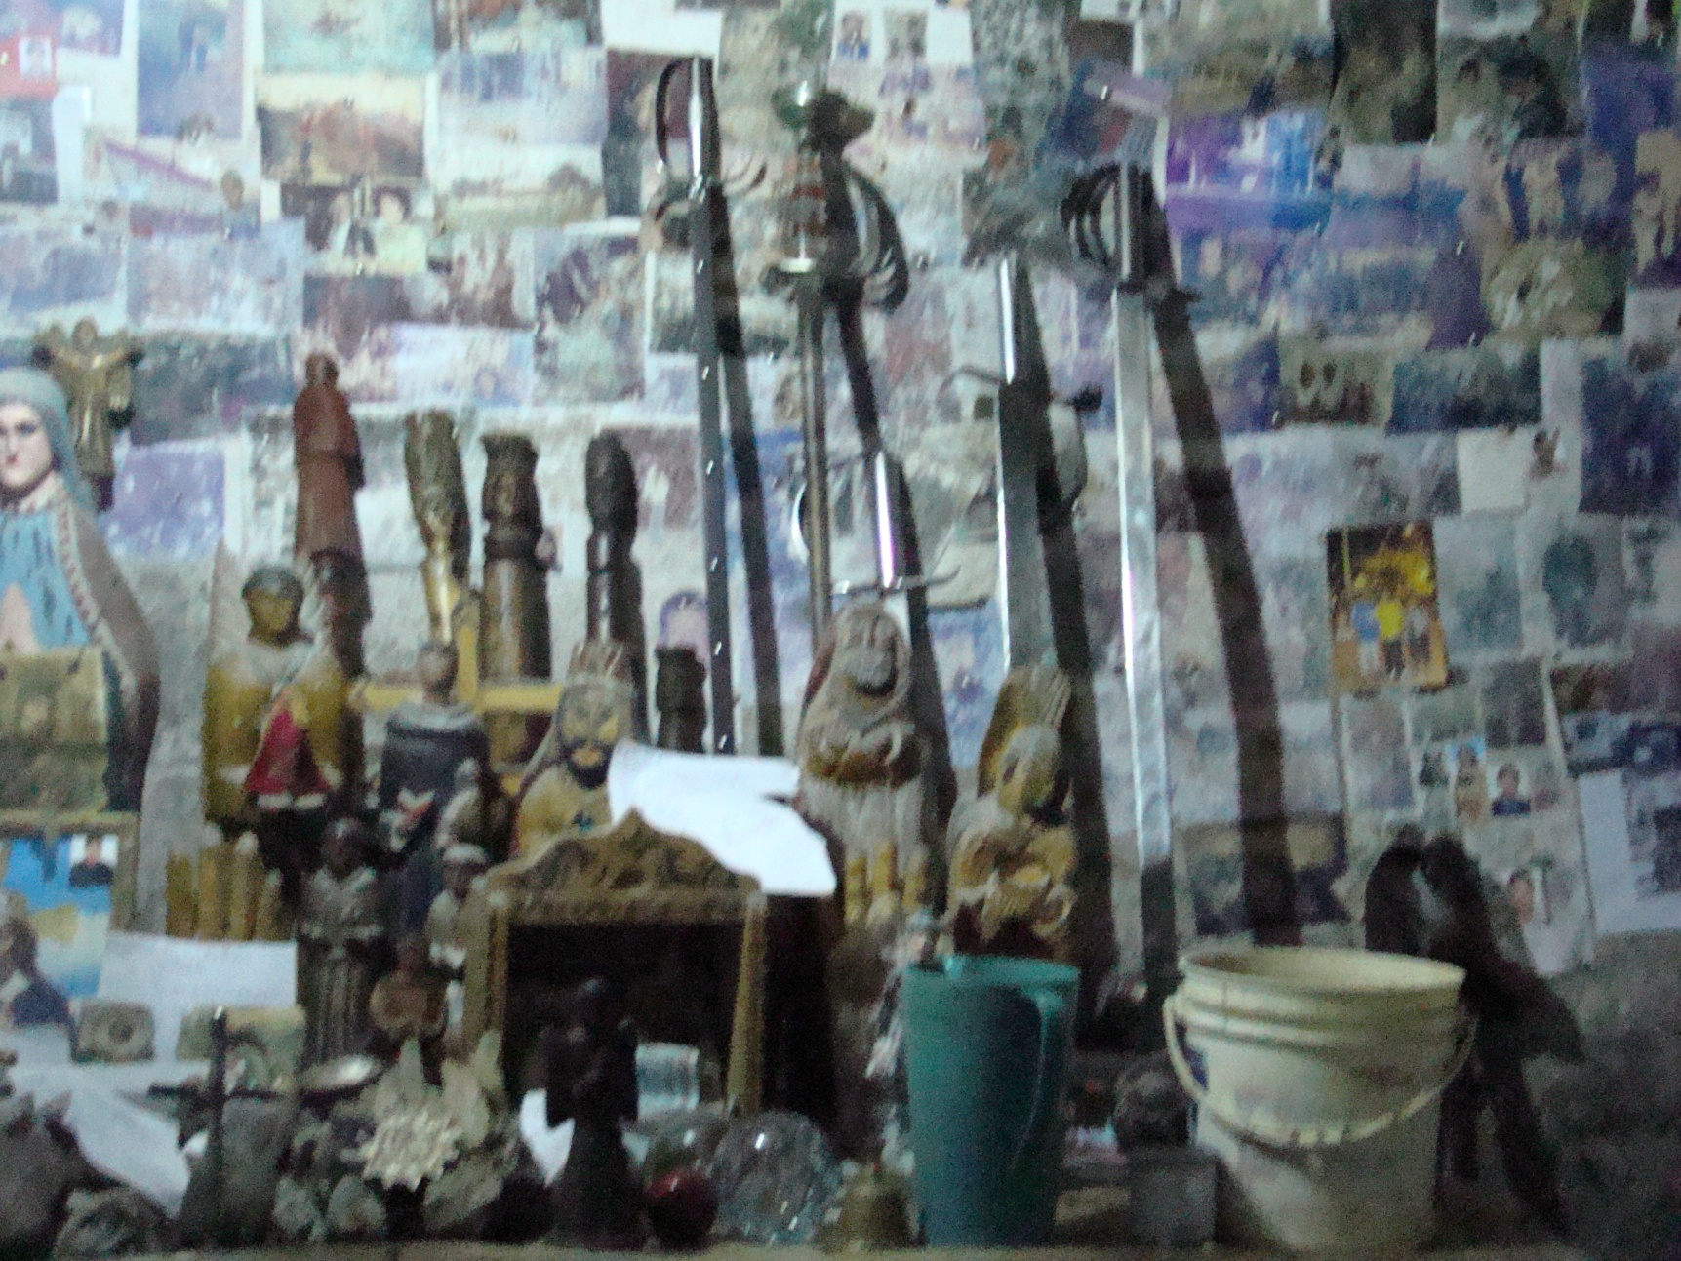
Wooden ‘wands’ called juntos direct energy and often contain tobacco juice shamans snort during ritual.
Copyright Dr. Lindsey Daniels PsyD

Slide 42
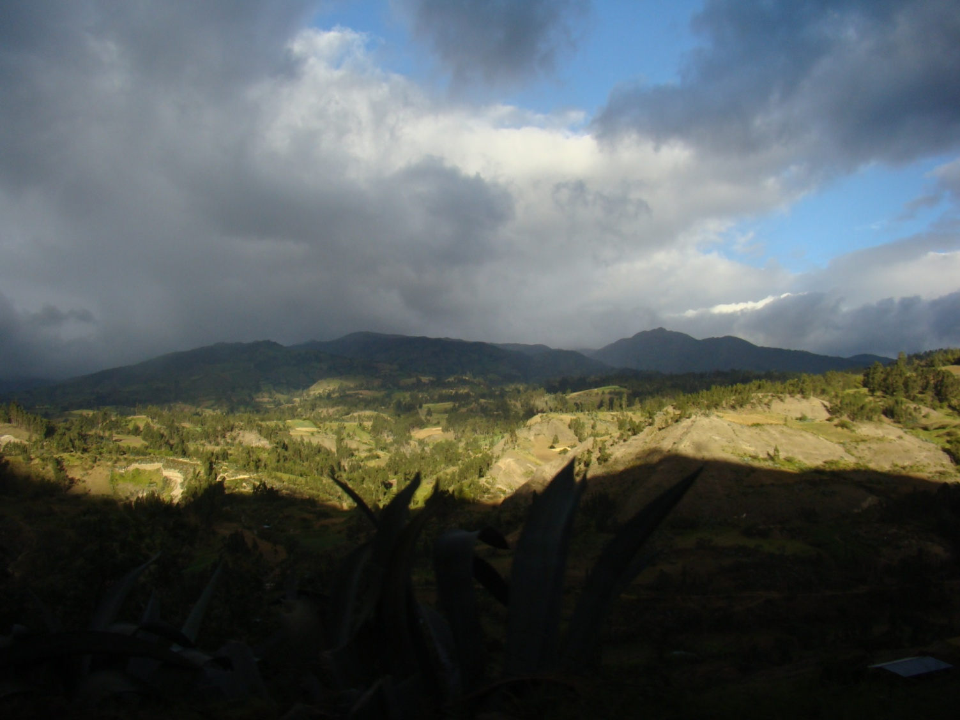
Initiation of a Shaman
One part of your initiation involves a dangerous quest. Even in today’s motorized society, the climate of the Andean Shaman and the Q’ero people is an unforgiving one.
Photo Credit Dr Lindsey Daniels PsyD

Slide 43
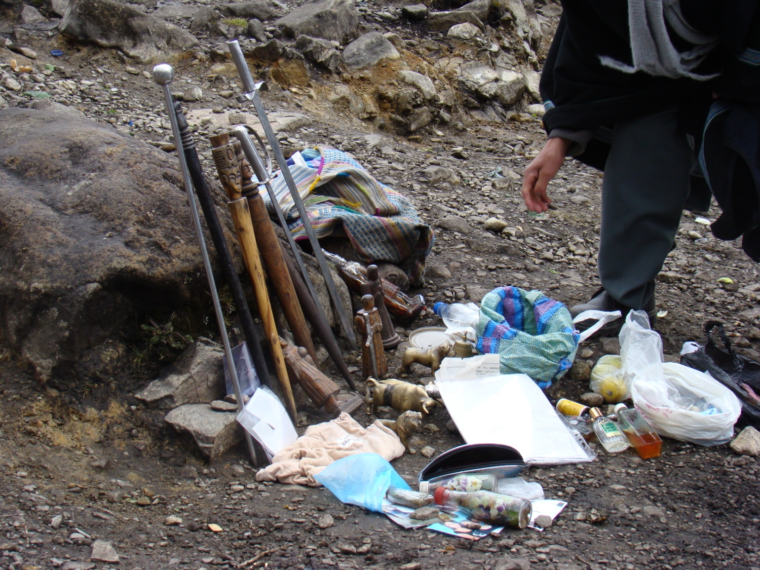
Initiation of a shaman
The quest involves a horse ride, with accompanying mules for the group’s supplies, and a hike once you reach the limit for the horses.

Slide 44
Initiation of a shaman
As well as a steep hike up into the mountain’s hidden river basin. At 15,000+ feet above sea level it’s a frigid journey no matter the time of year.

Slide 45
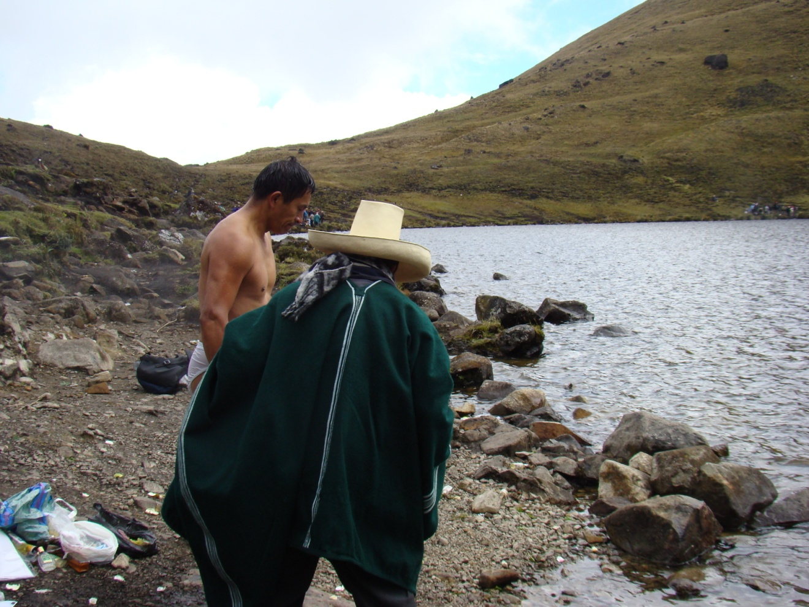
Initiation of a shaman
The Shaman –to –be must make a frigid dive into icy river waters fed by melting snow to cleanse himself of past disease and energetic ills, while the Maestro or head Shaman calls to the ancestors, the spirits, to the Goddess PachaMama and to the elements to witness his rebirth.

Slide 46
Initiation of a shaman
Copyright Dr. Lindsey Daniels PsyD

Slide 47
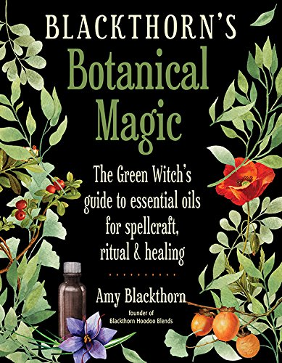
Blackthorn’s Botanical Magic
By Amy Blackthorn
Out September 1st 2018
Weiser Books
http://Facebook.com/amyblackthornauthor
First 50 Pages Free to Read and Download
http://tinyurl.com/blackthornsbotanicalmagic

